Slide 1
“Teach A Level Maths”
Statistics 1
The Median of Grouped Data
© Christine Crisp

Slide 2
Statistics 1
AQA
EDEXCEL
MEI/OCR
OCR
"Certain images and/or photos on this presentation are the copyrighted property of JupiterImages and are being used with permission under license. These images and/or photos may not be copied or downloaded without permission from JupiterImages"

Slide 3
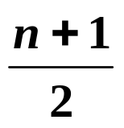
Finding the median of raw data is easy.
e.g.1 Find the median of
13
34
23
9
7
28
17
31
32
The data must be put in numerical order:
7
9
13
17
23
28
31
32
34
The median is the middle value, which we can see is the 5th value, so,
median = 23
The formula telling us which value we want is , where n is the number of data items.
If n is an even number, we average the 2 middle values.

Slide 4
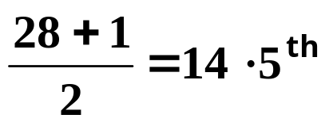
e.g.2 Find the median of
x | 1 | 2 | 3 | 4 | 5
f | 4 | 7 | 9 | 6 | 2
There are 28 observations so using we need:
We need to average the 14th and 15th numbers.
Accumulating the frequencies:
x
1
2
3
4
5
Cu. f
4
11
20
so, the 14th and 15th observations are both 3.
The median is 3.

Slide 5
With a grouped distribution, we can only estimate the median.
e.g. 3
Length (cm)
1 - 10
11 - 20
21 - 30
31 - 40
41 - 50
Frequency, f
3
4
5
6
3
There are 21 observations so we want to estimate the size of the 11th one. It lies in the 3rd class.

Slide 6
With a grouped distribution, we can only estimate the median.
e.g. 3
Length (cm)
1 - 10
11 - 20
21 - 30
31 - 40
41 - 50
Frequency, f
3
4
5
6
3
There are 21 observations so we want to estimate the size of the 11th one. It lies in the 3rd class.
The first 2 classes have a cumulative frequency of 7,

Slide 7
With a grouped distribution, we can only estimate the median.
e.g. 3
Length (cm)
1 - 10
11 - 20
21 - 30
31 - 40
41 - 50
Frequency, f
3
4
5
6
3
There are 21 observations so we want to estimate the size of the 11th one. It lies in the 3rd class.
The first 2 classes have a cumulative frequency of 7,
so to reach 11, we need 4 more.

Slide 8
With a grouped distribution, we can only estimate the median.
e.g. 3
Length (cm)
1 - 10
11 - 20
21 - 30
31 - 40
41 - 50
Frequency, f
3
4
5
6
3
There are 21 observations so we want to estimate the size of the 11th one. It lies in the 3rd class.
The first 2 classes have a cumulative frequency of 7,
so to reach 11, we need 4 more.
The 3rd class has a frequency of 5 so we need to go part-way along this class.

Slide 9
With a grouped distribution, we can only estimate the median.
e.g. 3
Length (cm)
1 - 10
11 - 20
21 - 30
31 - 40
41 - 50
Frequency, f
3
4
5
6
3
There are 21 observations so we want to estimate the size of the 11th one. It lies in the 3rd class.
The first 2 classes have a cumulative frequency of 7,
so to reach 11, we need 4 more.
The 3rd class has a frequency of 5 so we need to go part-way along this class.

Slide 10
With a grouped distribution, we can only estimate the median.
e.g. 3
Length (cm)
1 - 10
11 - 20
21 - 30
31 - 40
41 - 50
Frequency, f
3
4
5
6
3
There are 21 observations so we want to estimate the size of the 11th one. It lies in the 3rd class.
The first 2 classes have a cumulative frequency of 7,
The 3rd class has a frequency of 5 so we need to go part-way along this class.
so to reach 11, we need 4 more.
Coming up with our own method, needing 4 out of the frequency of 5, we would go 4/5th along the class.
The class is 10 wide

Slide 11
With a grouped distribution, we can only estimate the median.
e.g. 3
Length (cm)
1 - 10
11 - 20
21 - 30
31 - 40
41 - 50
Frequency, f
3
4
5
6
3
There are 21 observations so we want to estimate the size of the 11th one. It lies in the 3rd class.
The first 2 classes have a cumulative frequency of 7,
so to reach 11, we need 4 more.
The 3rd class has a frequency of 5 so we need to go part-way along this class.
Coming up with our own method, needing 4 out of the frequency of 5, we would go 4/5th along the class.
The class is 10 wide
and 4/5th of 10 is 8.

Slide 12
With a grouped distribution, we can only estimate the median.
e.g. 3
Length (cm)
1 - 10
11 - 20
21 - 30
31 - 40
41 - 50
Frequency, f
3
4
5
6
3
There are 21 observations so we want to estimate the size of the 11th one. It lies in the 3rd class.
The first 2 classes have a cumulative frequency of 7,
so to reach 11, we need 4 more.
The 3rd class has a frequency of 5 so we need to go part-way along this class.
Coming up with our own method, needing 4 out of the frequency of 5, we would go 4/5th along the class.
The class is 10 wide
and 4/5th of 10 is 8.
We would go 8 along the class, which starts at 20·5,

Slide 13
20·5
With a grouped distribution, we can only estimate the median.
e.g. 3
Length (cm)
1 - 10
11 - 20
21 - 30
31 - 40
41 - 50
Frequency, f
3
4
5
6
3
There are 21 observations so we want to estimate the size of the 11th one. It lies in the 3rd class.
The first 2 classes have a cumulative frequency of 7,
so to reach 11, we need 4 more.
The 3rd class has a frequency of 5 so we need to go part-way along this class.
Coming up with our own method, needing 4 out of the frequency of 5, we would go 4/5th along the class.
The class is 10 wide
and 4/5th of 10 is 8.
We would go 8 along the class, which starts at 20·5,

Slide 14
With a grouped distribution, we can only estimate the median.
e.g. 3
Length (cm)
1 - 10
11 - 20
21 - 30
31 - 40
41 - 50
Frequency, f
3
4
5
6
3
There are 21 observations so we want to estimate the size of the 11th one. It lies in the 3rd class.
The first 2 classes have a cumulative frequency of 7,
so to reach 11, we need 4 more.
The 3rd class has a frequency of 5 so we need to go part-way along this class.
Coming up with our own method, needing 4 out of the frequency of 5, we would go 4/5th along the class.
The class is 10 wide
and 4/5th of 10 is 8.
giving 28 ·5.
We would go 8 along the class, which starts at 20·5,
This is a reasonable estimate but not quite the accepted method which is called Linear Interpolation.

Slide 15

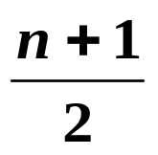
With a grouped distribution, we can only estimate the median.
e.g. 3
Length (cm)
1 - 10
11 - 20
21 - 30
31 - 40
41 - 50
Frequency, f
3
4
5
6
3
Our reasoning was:
The median is the 11th observation.
There are 7 in class 1 and class 2.
We need to add 4 to reach the median.
We need to assume the data are evenly distributed in the 3rd class and it can be shown that this means the median is found at 3·5 along the class not 4.
You don’t need to know the reason for this but I’ve put an explanation at the end of the presentation.
If you liked our reasoning to get to the estimate, stick to it, but in locating the median use instead of and
you will get the correct answer.

Slide 16
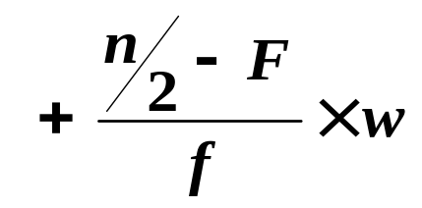




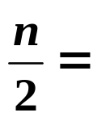

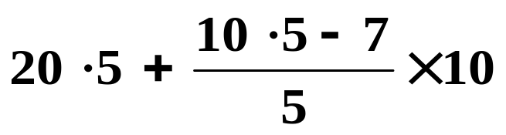








With a grouped distribution, we can only estimate the median.
e.g. 3
Length (cm)
1 - 10
11 - 20
21 - 30
31 - 40
41 - 50
Frequency, f
3
4
5
6
3
If you prefer to use a formula to find the estimate of the median, the formula is given by
where,

Slide 17

SUMMARY
To use linear interpolation to find an estimate of the median for a grouped frequency distribution, we
locate the class containing the median using total frequency divided by 2,
use
where,
F is the cumulative frequencies up to the class containing the median,
( think of n/2 – F as the distance along the class to the median ),
f is the frequency of the class containing the median,
w is the width of the class containing the median.
or, use reasoning to save the need to remember the formula.

Slide 18
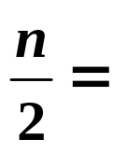

e.g.1 Estimate the median for the following:.
Height (cm)
1 - 5
6 - 10
11 - 15
16 - 20
Frequency, f
7
10
8
5
n
=
30
Solution:
The median is in the 2nd class.
Method 1: Without the formula,
The 1st class has 7 . . .

Slide 19
e.g.1 Estimate the median for the following:.
Height (cm)
1 - 5
6 - 10
11 - 15
16 - 20
Frequency, f
7
10
8
5
n
=
30
Solution:
The median is in the 2nd class.
Method 1: Without the formula,
The 1st class has 7 . . .
so we need to go 15 – 7 = 8 along the 2nd class.
There are 10 in the 2nd class . . .

Slide 20
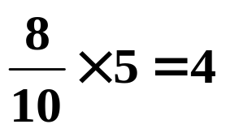
e.g.1 Estimate the median for the following:.
Height (cm)
1 - 5
6 - 10
11 - 15
16 - 20
Frequency, f
7
10
8
5
n
=
30
Solution:
The median is in the 2nd class.
Method 1: Without the formula,
The 1st class has 7 . . .
so we need to go 15 – 7 = 8 along the 2nd class.
There are 10 in the 2nd class . . .
so we want 8/10th of the class width:

Slide 21
e.g.1 Estimate the median for the following:.
Height (cm)
1 - 5
6 - 10
11 - 15
16 - 20
Frequency, f
7
10
8
5
n
=
30
Solution:
The median is in the 2nd class.
Method 1: Without the formula,
The 1st class has 7 . . .
so we need to go 15 – 7 = 8 along the 2nd class.
There are 10 in the 2nd class . . .
so we want 8/10th of the class width:
The l.c.b. is 5·5, so the estimate of the median is 9·5.

Slide 22
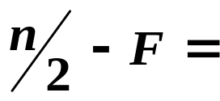
e.g.1 Estimate the median for the following:.
Height (cm)
1 - 5
6 - 10
11 - 15
16 - 20
Frequency, f
7
10
8
5
n
=
30
Solution:
Method 2: Using the formula,
where,
distance along class:

Slide 23

e.g.1 Estimate the median for the following:.
Height (cm)
1 - 5
6 - 10
11 - 15
16 - 20
Frequency, f
7
10
8
5
n
=
30
Solution:
Method 2: Using the formula,
where,
distance along class:

Slide 24

e.g.1 Estimate the median for the following:.
Height (cm)
1 - 5
6 - 10
11 - 15
16 - 20
Frequency, f
7
10
8
5
n
=
30
Solution:
Method 2: Using the formula,
where,
distance along class:

Slide 25

e.g.1 Estimate the median for the following:.
Height (cm)
1 - 5
6 - 10
11 - 15
16 - 20
Frequency, f
7
10
8
5
n
=
30
Solution:
Method 2: Using the formula,
where,
distance along class:
frequency of class,

Slide 26

e.g.1 Estimate the median for the following:.
Height (cm)
1 - 5
6 - 10
11 - 15
16 - 20
Frequency, f
7
10
8
5
n
=
30
Solution:
Method 2: Using the formula,
where,
distance along class:
frequency of class,

Slide 27

e.g.1 Estimate the median for the following:.
Height (cm)
1 - 5
6 - 10
11 - 15
16 - 20
Frequency, f
7
10
8
5
n
=
30
Solution:
Method 2: Using the formula,
where,
distance along class:
frequency of class,
width of class,

Slide 28
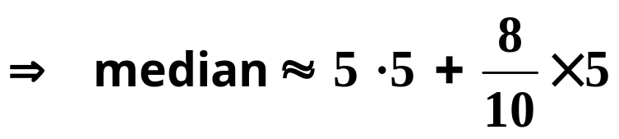

e.g.1 Estimate the median for the following:.
Height (cm)
1 - 5
6 - 10
11 - 15
16 - 20
Frequency, f
7
10
8
5
n
=
30
Solution:
Method 2: Using the formula,
where,
distance along class:
frequency of class,
width of class,

Slide 29
In the next example and the solutions to the exercise, I’ve used the formula.
However, if you choose to use the formula, you will need to memorize it.
If you find it easy to work each problem out using reasoning, just stick to that. It’s all the formula is doing anyway.

Slide 30

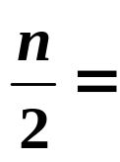



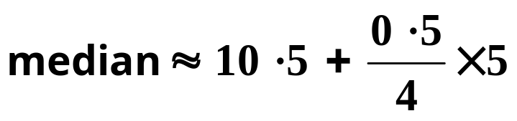

e.g.2 Estimate the median for the following:.
Height (cm)
1 - 5
6 - 10
11 - 15
16 - 20
Frequency, f
2
3
4
2
Solution:
The median is in the 3rd class.
distance along class:
class width =

Slide 31

Exercise
Use linear interpolation to estimate the median of the following:
1.
Length(cm)
21 - 30
31 - 35
36 - 40
41 - 50
Frequency, f
5
7
10
6
2.
Age (yrs)
10 - 12
13 - 15
16 - 18
Frequency, f
20
24
16

Slide 32
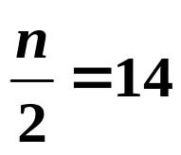



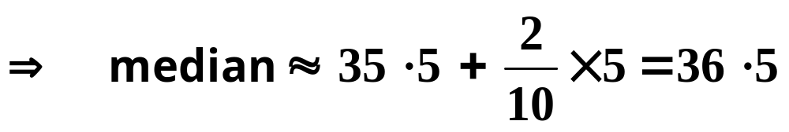
Solutions:
1.
Length(cm)
21 - 30
31 - 35
36 - 40
41 - 50
Frequency, f
5
7
10
6
The median is in the 3rd class.
distance along class:
class width =

Slide 33
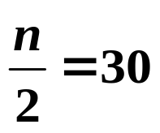



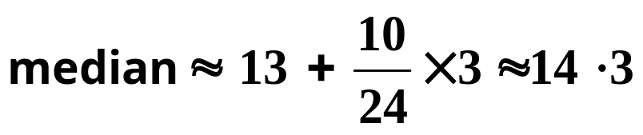
2.
Age (yrs)
10 - 12
13 - 15
16 - 18
Frequency, f
20
24
16
Solution:
The median is in the 2nd class.
distance along class:
class width =
As the data give ages, the boundaries are 13 and 16, not 12·5 and 15·5.

Slide 34
The next 4 slides show you how the linear interpolation formula is derived.
You are not expected to know the derivation so you can skip over them unless you are interested.
SKIP

Slide 35
We’ll start with the example we used before.
e.g. 3
Length (cm)
1 - 10
11 - 20
21 - 30
31 - 40
41 - 50
Frequency, f
3
4
5
6
3
There are 21 observations so we want to estimate the size of the 11th one. It lies in the 3rd class.
Since we have 7 observations in the first 2 classes, the median is the 4th value in the 3rd class.
The observations could be anywhere in the class but on average we expect them to be evenly spaced so we assume that the 3rd class looks like this:
20·5
30·5
x
x
x
x
x
21·5
23·5
25·5
27·5
29·5
The estimate of the median is 27·5.

Slide 36
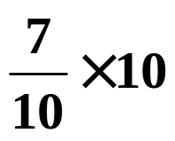
Length (cm)
1 - 10
11 - 20
21 - 30
31 - 40
41 - 50
Frequency, f
3
4
5
6
3
3rd class:
0·5
1
1
1
20·5
30·5
x
x
x
x
x
21·5
23·5
25·5
27·5
29·5
We need to express this as a formula.
The diagram shows we want to add 7 to the l.c.b.
This is 7 tenths of the class width or
The 7 tenths comes from 3·5 parts of the 5 parts given by the class frequency.

Slide 37
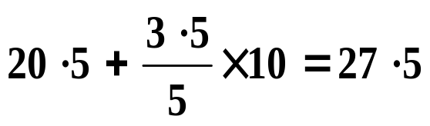
Length (cm)
1 - 10
11 - 20
21 - 30
31 - 40
41 - 50
Frequency, f
3
4
5
6
3
3rd class:
20·5
30·5
x
x
x
x
x
21·5
23·5
25·5
27·5
29·5
We need to express this as a formula.
The diagram shows we want to add 7 to the l.c.b.
This is 7 tenths of the class width or
The 7 tenths comes from 3·5 parts of the 5 parts given by the class frequency.
So, the estimate is:

Slide 38
Length (cm)
1 - 10
11 - 20
21 - 30
31 - 40
41 - 50
Frequency, f
3
4
5
6
3
3rd class:
20·5
30·5
x
x
x
x
x
21·5
23·5
25·5
27·5
29·5
The estimate of the median is:
In general, we have
We can think of n/2 – F as the distance along the class to the median.
f is the frequency and w the width, both for the class containing the median.

Slide 39
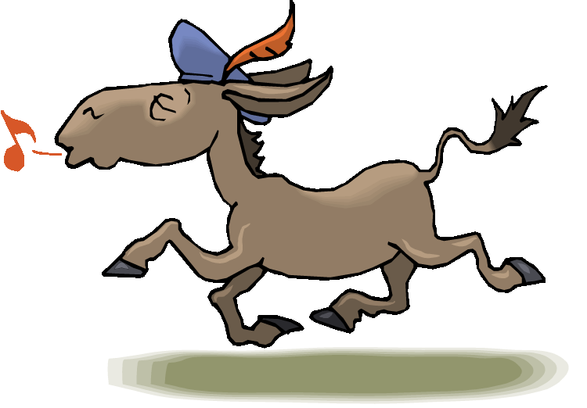

Slide 40
The following slides contain repeats of information on earlier slides, shown without colour, so that they can be printed and photocopied.
For most purposes the slides can be printed as “Handouts” with up to 6 slides per sheet.

Slide 41
SUMMARY
To use linear interpolation to find an estimate of the median for a grouped frequency distribution, we
locate the class containing the median using total frequency divided by 2,
use
where,
F is the cumulative frequencies up to the class containing the median,
( think of n/2 – F as the distance along the class to the median ),
f is the frequency of the class containing the median,
w is the width of the class containing the median.
or, use reasoning to save the need to remember the formula.

Slide 42
e.g.1 Estimate the median for the following:.
Height (cm)
1 - 5
6 - 10
11 - 15
16 - 20
Frequency, f
7
10
8
5
n
=
30
Solution:
The median is in the 2nd class.
where,
distance along class:
frequency of class,
width of class,

Slide 43
e.g.2 Estimate the median for the following:.
Height (cm)
1 - 5
6 - 10
11 - 15
16 - 20
Frequency, f
2
3
4
2
Solution:
The median is in the 3rd class.
distance along class:
class width =

